Slide 1
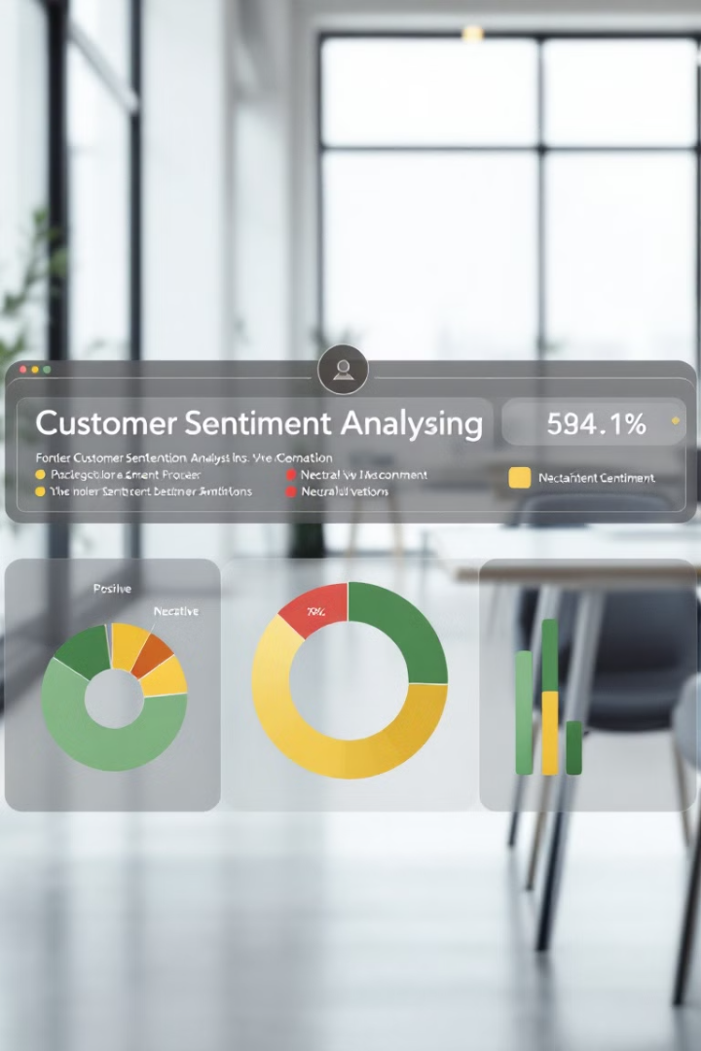

Customer Sentiment Analysis Report
This project analyzes customer sentiment from Amazon reviews for musical instruments. By leveraging data science techniques, we aim to uncover insights into customer feedback, trends over time, and key themes. The analysis results provide actionable recommendations for improving products and customer satisfaction.
by Jayesh Panigrahi

Slide 2
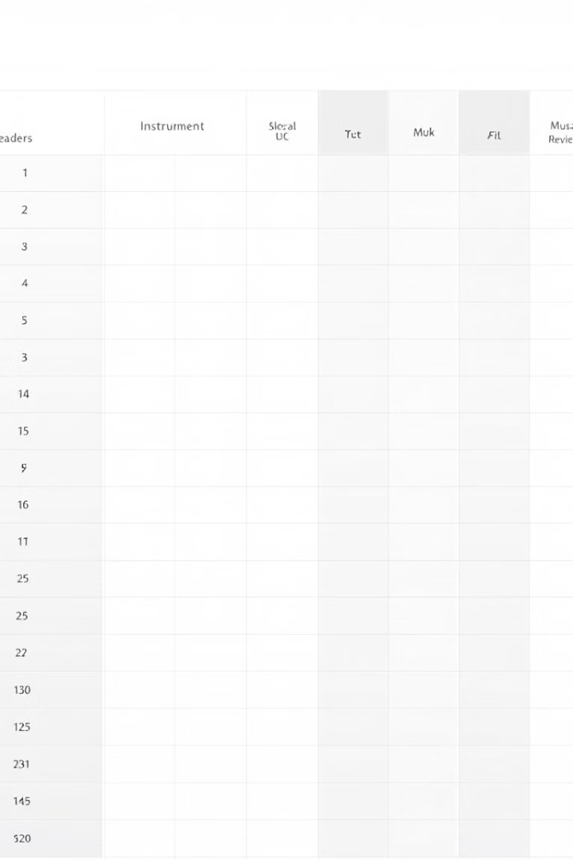
Data Overview
Dataset Name
Total Records
Amazon Musical Instruments Reviews
10,261
Key Features
Reviewer ID, Product ID (ASIN), Review Text, Rating (1-5), Review Time, Summary

Slide 3
Exploratory Data Analysis (EDA)
Dataset Insights
Ratings Distribution
All columns have non-null values except "reviewerName" and "reviewText" with negligible missing values. Average review length is 468 characters. No strong correlation between review length and rating (-0.07).
5-Star Reviews: 67.6% 4-Star Reviews: 20.3% 1- and 2-Star Reviews: 4.6%

Slide 4



Sentiment Analysis
1
Positive: 87.55%
2
Neutral: 2.99%
3
Negative: 9.45%
Sentiment trends show 91.8% of 5-star reviews are positive, while 48.4% of 1-star reviews are negative. Top keywords in negative reviews include "not," "poor," "quality," "guitar," and "doesn't". Positive sentiment peaked in 2013 and slightly declined in 2014.

Slide 5




Topic Modeling
Topic 1
Topic 2
Keywords: "guitar," "pedal," "sound," "tone" Focus: Sound quality and accessories
Keywords: "price," "cable," "stand," "quality" Focus: Price and accessory usability
Topic 3
Keywords: "strings," "picks," "use," "durability" Focus: String performance and durability

Slide 6




Challenges Faced and Solutions
Data Quality Issues
Missing values in "reviewerName" and "reviewText". Solution: Imputed or removed missing values without affecting overall analysis.
Dependency Conflicts
Package version incompatibilities. Solution: Resolved conflicts by ensuring consistent package versions and leveraging virtual environments.
Sentiment Classification Precision
Difficulty in accurately classifying neutral reviews. Solution: Adjusted thresholds and used additional metrics for better sentiment classification.

Slide 7

Recommendations
Product Quality Enhancements
Pricing and Value Perception
Customer Feedback Utilization
Address issues highlighted in negative reviews, especially for guitars and straps. Focus on improving strings and sound accessories.
Highlight affordability and value in marketing campaigns. Address pricing concerns in negative reviews.
Actively engage with customers who leave detailed reviews. Create feedback loops to address recurring issues in clusters.

Slide 8

Data Export Summary
1
EDA Results
Statistics and trends
2
Sentiment Analysis Data
Sentiment scores and classifications
3
Topic Modeling Data
Keywords and cluster associations

Slide 9

Conclusion
This analysis highlights significant trends and insights in customer reviews for musical instruments. With actionable recommendations derived from sentiment analysis, topic modeling, and EDA, this project provides a solid foundation for enhancing customer satisfaction and product offerings.

